Slide 1
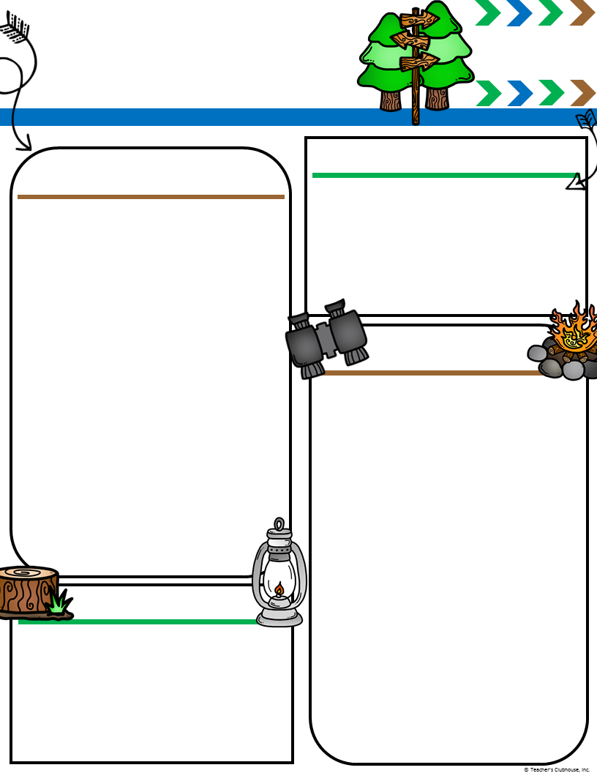
Adamson’s
Second Grade
334-887-4950
jdadamson@auburn
schools.org
Memos
February 10-14
Upcoming Events
A Peek at Our Week
February 14 Valentine’s Day Party
February 21 Mrs. Adamson out
February 24 Bookfair Lunch at 11:50
February 25 Family Literacy Night @6pm
March 19 Field Trip to Tuskegee (all day) *Please let me know if you would like to chaperone. It’s an amazing trip!
Reading: We will read Somebody Loves You, Mr. Hatch by Eileen Spinelli. We will identify the author’s point of view!
Math: We will learn about collecting data, making graphs, and interpreting the data. We will also continue to add and subtract 3-digit numbers with and without regrouping.
Writing: We will write opinion pieces.
Science/Social Studies: We will learn about time lines and compare the past to the present!
Language: We will learn about abbreviations.
Spelling: We will learn words with er, ir, and ur. (ex. verb, shirt, purple)
Quarter Three Sight Words: sound, almost, great, example, only, turn, between, animal, little, same, fought, while, things, also, began, change, important, means, often, until
Homework
Monday:
Read 20 Minutes.
Math: Math: GO MATH lesson 10.5
Tuesday:
Read 20 minutes.
Math: GO MATH lesson 10.6
Wednesday:
Read 20 minutes.
Math: GO MATH Chapter 10 Chekpoint
Thursday:
Read 20 minutes.
Math: Finish up Valentine Cards
Friday: Read 1 night over the weekend
FEBRUARY 11 FIELD TRIP INFO:
Students may wear their AEEC t-shirt or GLOW t-shirt on the Rosie Revere Field Trip. We will eat lunch at school when we return.
Enjoy your weekend!
Reminders
Our class will celebrate Valentine’s Day on February 14! Please send in 20 Valentines. Please make sure that the student’s names are already printed on the Valentines! I have included a class list on the back of this newsletter!

